Slide 1
Lecture 5

Slide 2
Module 17

Slide 3









Q.) Form the quadratic equation if its roots are
–3 and –11
Sol:
The roots of the quadratic equation are –3 and –11.
Let
α = –3
and
β = –11
Sum of the roots :
For forming a quadratic equation two things are required
α + β
=
–3
+ (–11)
=
–3
– 11
=
– 14
Product of the roots :
α . β
=
–3
×
Sum of the roots
– 11
=
33
The required quadratic equation is
Product of the roots
x² – (sum of the roots)x + Product of the roots = 0
$$x2−\left(α+ β\right)x+ αβ=0$$
$$∴ x2−$$
$$x$$
$$(−14)$$
$$+$$
$$33$$
$$=0$$
$$∴$$
x²
+
14x
+
33
=
0
$$∴$$
The required quadratic equation is x² + 14x + 33 = 0

Slide 4



























Q.) Form the quadratic equation if its roots are $\frac{1}{2}$ and – $\frac{3}{4}$
Sol:
The roots of the quadratic equation are $\frac{1}{2}$ and $−\frac{3}{4}$
+ 8 × $\frac{1}{4}\text{x}$
– 8 × $\frac{3}{8}$
2
For forming a quadratic equation two things are required
= 0
Let α and β be the roots of the quadratic equation
8 × x²
$$\text{}= \frac{1}{2} and β =−\frac{3}{4}$$
To remove 4 & 8 from the denominator multiply by their LCM i.e. 8
Now, required quadratic equation is
8x²
+ 2x
– 3 = 0
Sum of the roots :
x² – (sum of the roots) x + Product of the roots = 0
$$\frac{1}{2}$$
Sum of the roots
$$+\left(−\frac{3}{4}\right)$$
$$x2−\left(\text{α}+ β\right)x+ αβ=0$$
α + β =
$$\left(−\frac{1}{4}\right)$$
$$\left(−\frac{3}{8}\right)$$
Product of the roots
$$\frac{1}{2}$$
$$∴ x2−$$
$$x +$$
$$=0$$
$$− \frac{3}{4}$$
∴ α + β =
$$\frac{2 −3}{4}$$
$$+ \frac{1}{4}x$$
$$−\frac{3}{8}$$
∴ α + β =
$$∴ x2$$
$$=0$$
$$\frac{−1}{4}$$
Multiplying throughout by 8 we get,
∴ α + β =
$$ 8x2+2x−3=0$$
Product of the roots :
$$$$
The required quadratic equation is $8x2+2x−3=0$
$$\frac{1}{2}$$
$$× \frac{−3}{4}$$
$$=− \frac{3}{8}$$
αβ =

Slide 5











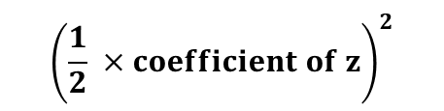












Q.) Form the quadratic equation if its roots are : (iv) – 2 and$\frac{11}{2}$
$$\text{The} \text{roots} \text{of} \text{the} \text{quadratic} \text{equation} \text{are}\text{ −2 }\text{a}nd \frac{11}{2}$$
Sol:
Let α and β be the roots of the quadratic equation
– 2 × $\frac{7}{2}\text{x}$
2 × x²
– 2 × 11 = 0
$$\text{}=−2 and β =\frac{11}{2}$$
For forming a quadratic equation two things are required
Now, required quadratic equation is
Remove 2 from denominator
2x²
– 7x
– 22 = 0
Sum of the roots :
x² – (sum of the roots)x + Product of the roots = 0
$$+\frac{11}{2}$$
α + β =
$$− 2$$
$$x2−\left(\text{α}+ β\right)x+ αβ=0$$
Sum of the roots
$$\frac{− 4+11}{2}$$
$$∴ x2−$$
$$\frac{7}{2}$$
∴ α + β =
$$x$$
$$+$$
$$\left(−11\right)$$
$$=0$$
Product of the roots
$$\frac{7}{2}$$
$$∴ x2$$
$$− \frac{7}{2}x$$
$$−11$$
$$=0$$
∴ α + β =
Multiplying throughout by 2 we get,
Product of the roots :
$$ 2x2−7x−22=0$$
$$×\frac{11}{2}$$
αβ =
$$− 2$$
$$$$
The required quadratic equation is $2x2−7x−22=0$
∴ αβ =
$$− 11$$

Slide 6
Module 18

Slide 7
























Q.) Form the quadratic equation with real coefficients,
if its one of the root is
It is an irrational root
Then other root will be its conjugate
3 – $2\sqrt{5}$
Sol:
If one of the root of the quadratic equation is
$$3−2 \sqrt{5},$$
$$3+2 \sqrt{5},$$
For forming a quadratic equation there are two things required
then the other root is
Let
$$3−2 \sqrt{5}$$
$$3+2 \sqrt{5}$$
Now, required quadratic equation is
α =
and
β =
Sum of the roots :
x² – (sum of the roots)x + Product of the roots = 0
$$3−2 \sqrt{5}$$
$$\text{+ }$$
$$3+2 \sqrt{5}$$
$$x2−\left(\text{α}+ β\right)x+ αβ=0$$
Sum of the roots
Now,
α + β
=
$$∴ x2−$$
$$6$$
$$x$$
$$+$$
$$\left(−11\right)$$
$$=0$$
∴ α + β
=
6
Product of the roots
$$∴$$
x²
–
6x
–
11
$=$
0
Product of the roots :
$$∴$$
The required quadratic
equation is x² - 6x - 11 = 0
and
α . β
($3−2 \sqrt{5}$)
($3+2 \sqrt{5}$)
=
(a $−$ b)
(a $+$ b)
∴ αβ =
($3$)²
– ($2 \sqrt{5}$)²
= a²$−$b²
∴ αβ =
(4
9
–
×
5)
∴ αβ =
9
–
20
∴ αβ =
– 11

Slide 8
























Q.) Form the quadratic equation if its one of the root is
2$\sqrt{3}$ – 4
It is an irrational root
Then other root will be its conjugate
$$2 \sqrt{3}−4$$
For forming a quadratic equation there are two things required
Sol:
If one root of the quadratic equation is
$$2\sqrt{3}+4$$
, then the other root is
$$2 \sqrt{3}−4$$
$$2 \sqrt{3}+4$$
Let α =
and β =
Sum of the roots :
Now, required quadratic equation is
α + β =
2$\sqrt{3}$ – 4
+
2$\sqrt{3}$ + 4
Sum of the roots
x² – (sum of the roots) x + Product of the roots = 0
∴ α + β =
4$\sqrt{3}$
$$x2−\left(α+ β\right)x+ αβ=0$$
Product of the roots
Product of the roots :
$$4 \sqrt{3}$$
$$∴ x2−$$
$$x$$
$$+$$
$$\left(−4\right)$$
$$=0$$
αβ =
($2 \sqrt{3}−4$)
($2 \sqrt{3}+4$)
(a $−$ b)
(a $+$ b)
$$∴ x2−4 \sqrt{3}x −4=0$$
∴ αβ =
($2 \sqrt{3}$)²
– (4)²
= a²$−$b²
$$∴$$
∴ αβ =
(4 × 3) – 16
$$\text{The} \text{required} \text{quadratic} \text{equation} \text{is}$$
∴ αβ =
$$x2−4 \sqrt{3}x−4=0$$
12 – 16
– 4
∴ αβ =

Slide 9



















Q.) Form the quadratic equation if its one of the root is
$$\sqrt{5}−\sqrt{3}$$
It is an irrational root
Then other root will be its conjugate
Sol:
$\sqrt{5}$ –$\sqrt{3}$
$\sqrt{5}$ +$\sqrt{3}$
If one root of the quadratic equation is
, then the other root is
Let α =
Now, required quadratic equation is
$\sqrt{5}$ –$\sqrt{3}$
$$and β=\sqrt{5}\text{ +}\sqrt{3}$$
For forming a quadratic equation there are two things required
Sum of the roots :
x² – (sum of the roots)x + Product of the roots = 0
α + β =
$\sqrt{5}$ – $\sqrt{3}$
$\sqrt{5}$ + $\sqrt{3}$
+
$$x2−\left(\text{α}+ β\right)x+ αβ=0$$
$$2\sqrt{5}$$
∴ α + β =
$$\text{} x2−$$
$$2\sqrt{5}$$
$$x$$
$$+$$
$$2$$
$$=0$$
Sum of the roots
Product of the roots :
$$\text{ }\text{The} \text{required} \text{quadratic} \text{equation}$$
$$\text{is} x2−2\sqrt{5}x+2=0$$
Product of the roots
αβ =
(a $−$ b)
(a $+$ b)
($\sqrt{5}\text{ – }\sqrt{3}$)
($\sqrt{5}\text{ + }\sqrt{3}$)
∴ αβ =
($\sqrt{5})2$
$$\text{– (}\sqrt{3})2$$
= a²$−$b²
∴ αβ =
5 – 3
∴ αβ =
2

Slide 10
Module 19

Slide 11



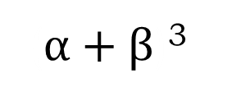





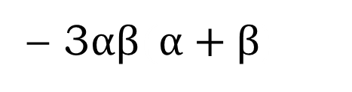






Formulae we need to know
α² + $β$² =
($α+β$)³
$$α+β$$
²
–
2$αβ$
α³ + $β$³ =
($α+β$)³
– 3$αβ(α+β\text{)}$
$$α+β$$
³
–
3$αβ$
$$α+β$$
α³ – $β$³ =
($α−β$)³
– 3$αβ(α−β\text{)}$
$$α−β$$
³
+
3$αβ$
$$α−β$$
(α - $β$)² =
($α+β$)³
$$α+β$$
²
–
4$αβ$

Slide 12
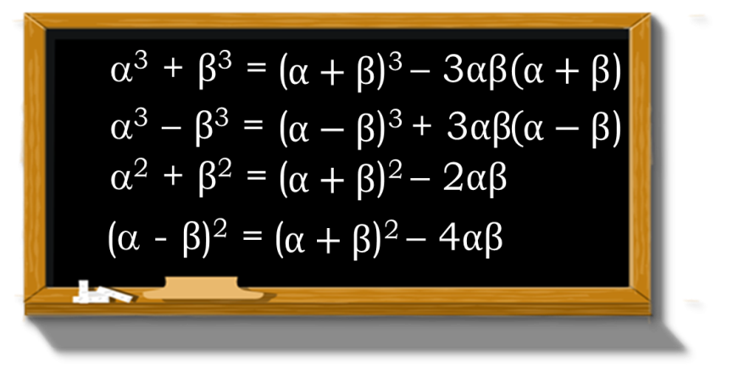

Q.) If the sum of the roots of the quadratic equation is 3 and sum of their cubes
is 63, find the quadratic equation.
Sol:
Let α and β be the roots of the required quadratic equation
α β
+
=
3
☑
α³ β³
α³ + β³
(α + β)
(α + β)
+
= 63
α³ + β ³ =
α + β
–
3αβ
( )
( )
α + β
³
∴ 63 =
(3)³
– 3αβ
(3)
∴ 63 =
27
– 9αβ
∴ 9αβ =
27
– 63
For forming a quadratic equations we require 2 things
Since there is one unknown we use one formula
Which formula is applicable as per the given information ?
Sum of the roots is known to us
Do we know the value of roots ?
What do we have to find ?
∴ 9αβ =
– 36
Product of the roots is unknown
∴ αβ =
– 4
We know that the required quadratic equation is
No
Sum of the roots
$$x2−\left(\text{α}+ β\right)x+ αβ=0$$
∴ x² –
3
x +
(– 4)
= 0
Product of the roots
∴ x² – 3x – 4 = 0
∴
The required quadratic equation is x² – 3x – 4 = 0

Slide 13

Q.) If the difference of the roots of the quadratic equation is 5 and the difference of
their cubes is 215, find the quadratic equation.
For forming a quadratic equation there are two things required.
Which formula is applicable as per the information ?
Now use anyone of the formula from the remaining formulae
Sol:
Let α and β be the roots of a quadratic equation.
Now we have to find α + β
α – β
=
5
∴
25
+
24
=
(α + β)²
α³ – β³
Sum of the roots
=
215
∴
(α + β)²
=
49
Also,
α³ – β ³ =
( )
α – β
³
+
3αβ
( )
α – β
Taking square root on both the sides, we get;
Product of the roots
∴
215
=
(5)³
+
3
α.β
(5)
α + β
=
±
7
We know that the required quadratic equation is
∴
215
☑
=
125
+
15
α.β
α³ – β³
(α – β)
(α – β)
x²
–
(α + β)
x
+
α . β
∴
215
=
0
–
125
=
15
α.β
∴
x²
–
(± 7)
x
∴
90
+
6
=
0
=
15
α.β
☑
What do we have to find ?
(α – β)²
αβ
Which formula is applicable as per the given information ?
$$\frac{90}{15}$$
Since both are unknown we need to use two formulae
Do we know the value of roots ?
∴
x²
–
(7) x
+
6
=
0
or
x²
–
( – 7) x
+
6
=
∴
α.β
=
0
∴
x²
–
7x
+
6
=
0
or
x²
+
7x
+
6
∴
α.β
=
6
=
0
Now,
(α – β)²
=
(α + β)²
∴
The required quadratic equation is x² – 7x + 6 = 0 or x² + 7x + 6 = 0.
–
4 α.β
No
∴
(5)²
=
(α + β)²
–
4
(6)
∴
25
=
(α + β)²
–
24

Slide 14
Module 20

Slide 15
Q.
If  and β are the zeros of the quadratic polynomial f(x) = x² – 5x + 4,
find the value of
1
1
– 2β.

+
β
Sol.
f(x)
=
x²
–
5x
+
4
1
Here
a
=
1,
b
=
–5,
c
=
4

 and β are the zeros of f(x)
–
–b
(–5)
∴

+
β
=
a
=
1
=
5
c
4
and
β
=
a
=
1
=
4
1
1
β
+

+
–
2β
=
–
2β

β
β
β
+


+
β
=
–
2β
β
5
5
=
4
–
2
×
4
=
4
–
8
1
5
–
32
–27
1
1
–27
=
=
∴
+
–
4
4

β
2β
=
4

Slide 16
Q.
If  and β are the zeros of the quadratic polynomial p(y) = 5y² – 7y + 1,
1
1
find the value of .

+
β
Sol.
p(y)
=
5y²
–
7y
+
1
Here
a
=
5,
b
=
–7,
c
=
1

 and β are the zeros of p(y)
–b
–
(–7)
7
∴

+
β
=
a
=
5
=
5
c
1
and
β
=
a
=
5
β

+

1
1
+

β
+
β

+
=
=
β
β
β
7
5
7
1
7
5
=
=
÷
=
×
=
7
1
5
5
5
1
5
∴
1
1
7

+
β
=

Slide 17
Thank You

